Slide 1


EVENT
MANAGEMENT SYSTEM

Slide 2
EVENT MANAGEMENT SYSTEM
MEMBERS ROLL NO
Varad Ramchandra Patil 13
2. Sakshi Lahuraj Pawar 21
3. Daksha Rajkumar Patil 22
4. Shravani Shrikant Patil 24
5. Shreya Shrishail Kakade 25

Slide 3

Introduction
1
The Event Management System is a desktop application developed using Java Swing that enables users to efficiently manage various events. It offers a graphical user interface for easy interaction, allowing users to log in, create events, and view event details in a structured and organized manner. The system is designed to enhance productivity and streamline the event planning process, making it easier to handle event-related information from a single platform.

Slide 4




OBJECTIVES
2
1. Efficient Event Handling
2. User-Friendly Interface
To provide a simple interface for creating, updating, and managing events.
To ensure smooth navigation and interaction through an intuitive GUI using Java Swing.
3. Data Organization
4. Improved Event Tracking
To store and display event information in a structured and accessible format.
To help users easily monitor and manage upcoming and past events.

Slide 5
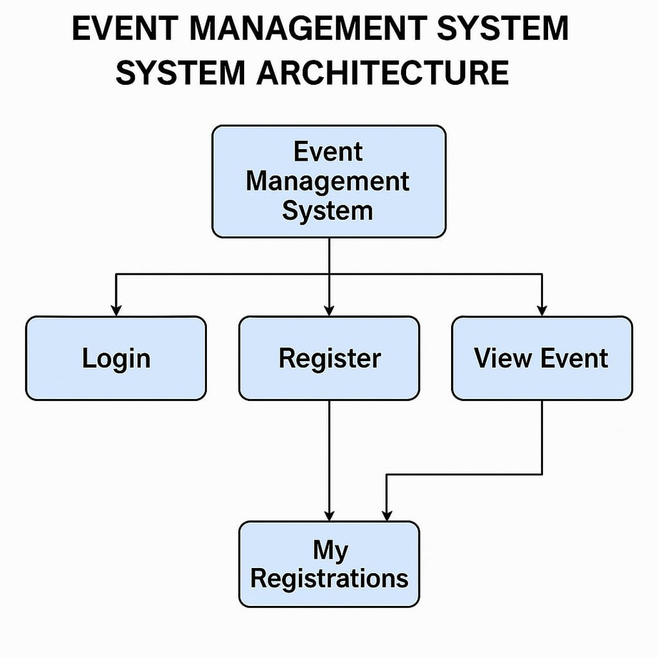
SYSTEM ARCHITECTURE
3
The Event Management System is developed using Java GUI (Swing Framework).
It follows a basic three-tier architecture consisting of:
Presentation Layer – Built using Java Swing, provides a graphical user interface for user interaction.
Logic Layer – Handles core functionalities such as event creation, validation, and data processing.
Data Layer – Connects to the database (e.g., MySQL/SQLite) for storing and retrieving event-related information.

Slide 6
WORKING OF SYSTEM
4
User Interaction through GUI
The user launches the application and interacts with the system using a graphical interface built with Java Swing (e.g., login, add/view events).
WORKFLOW
Processing and Validation
The system processes user inputs, performs necessary validations, and executes actions like saving event data, updating entries, or displaying event lists.
Data Storage and Retrieval
All data is stored in the connected database (like MySQL), allowing efficient retrieval and management of event information whenever required.

Slide 7



JAVA CONCEPTS USED
6
1. Object-Oriented Programming
2. Swing Framework
3. Event Handling
The system uses classes and objects (e.g., AddEvent, Login, Dashboard) and follows OOP principles such as encapsulation and inheritance.
Java Swing components like JFrame, JLabel, JTextField, JButton, and JTable are used to build the graphical user interface of the system.
Implements event listeners (ActionListener, MouseListener) to handle button clicks and user interactions within the application.

Slide 8
THANK
YOU

